Slide 1
COMP 3500 Introduction to Operating Systems Midterm Exam 2 Exercises
Dr. Xiao Qin
Auburn University http://www.eng.auburn.edu/~xqin
xqin@auburn.edu
Notes:
25 Min: Lec07c1-Project 3-6 Cats and Mice Implementation CV cont
25 Min: Lec07c2 This lecture note. Slides 1-10
No resource allocation graphs: next lecture Slides 11-18

Slide 2
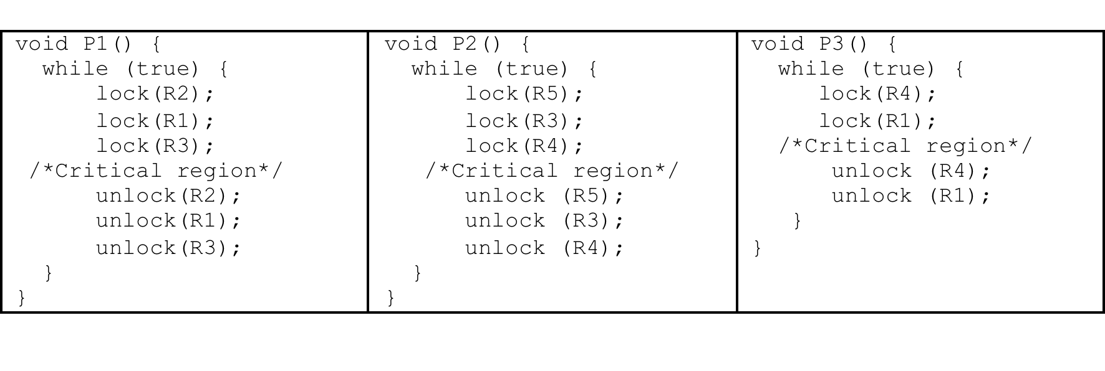
Exercise 1:
There are three processes accessing four resources labeled from R1 to R5. Please use a resource allocation graph to detect if there is a possible deadlock.
Notes:
References: http://web.stanford.edu/class/cs140/cgi-bin/lecture.php?topic=locks
Operations:
cv_wait - Release the supplied lock, go to sleep, and, after
waking up again, re-acquire the lock.
cv_signal - Wake up one thread that's sleeping on this CV.
cv_broadcast - Wake up all threads sleeping on this CV.

Slide 3
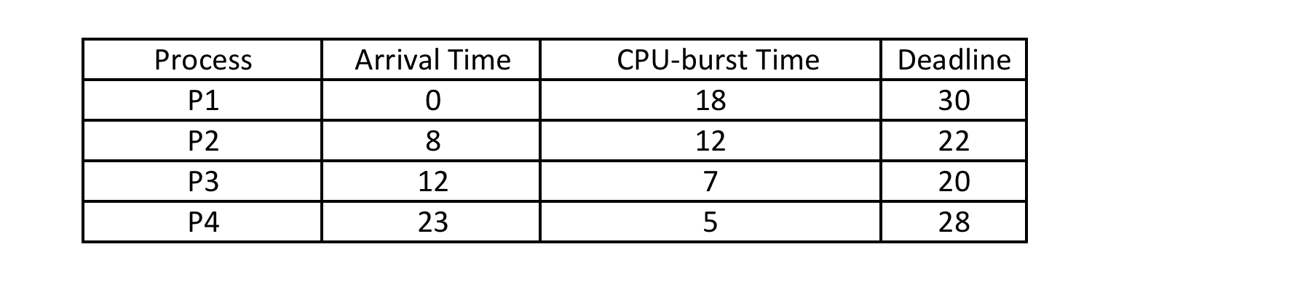
Exercise 2:
The following four processes are scheduled by the deadline-driven scheduler, which give high priorities to processes with the earliest deadlines. We assume that a newly arrived process with a loose deadline.
Draw a Gantt chart illustrating the execution of these.
Which processes miss their deadlines?
What are the turnaround times of the four processes?
What are the waiting times of the four processes?
Notes:
References: http://web.stanford.edu/class/cs140/cgi-bin/lecture.php?topic=locks
Operations:
cv_wait - Release the supplied lock, go to sleep, and, after
waking up again, re-acquire the lock.
cv_signal - Wake up one thread that's sleeping on this CV.
cv_broadcast - Wake up all threads sleeping on this CV.

Slide 4
FAQ 1
In the slides on this topic none of the examples say anything about arrival times. But the example we did in class today did have arrival times. Which techniques take into account the arrival times of the processes?
Answer: In static scheduling, there is no arrival time; in dynamic scheduling, there are arrival times.
Notes:
References: http://web.stanford.edu/class/cs140/cgi-bin/lecture.php?topic=locks
Operations:
cv_wait - Release the supplied lock, go to sleep, and, after
waking up again, re-acquire the lock.
cv_signal - Wake up one thread that's sleeping on this CV.
cv_broadcast - Wake up all threads sleeping on this CV.

Slide 5
FAQ 2
For FCFS, shortest job next and priority scheduling. Do these techniques ever allow a process to be interrupted? In the examples on the slides every process executes all the way through before the next process starts. Is this how these techniques always behave?
How do we know if a process can be interrupted or not when trying to draw the Gantt chart and find turnaround time?
Answer: Most scheduling techniques fall into two camps: preemptive and non-preemtive schedulers. The scheduler we studied in our today's class is a preemptive one, meaning that one process may interrupt a running process.
In our previous lectures, we simply show non-preemptive schedulers.
Notes:
References: http://web.stanford.edu/class/cs140/cgi-bin/lecture.php?topic=locks
Operations:
cv_wait - Release the supplied lock, go to sleep, and, after
waking up again, re-acquire the lock.
cv_signal - Wake up one thread that's sleeping on this CV.
cv_broadcast - Wake up all threads sleeping on this CV.

Slide 6
Exercise 3:
Given a paging system that has 2³² bytes of physical memory. We assume the page size is 2¹⁰ bytes, and the size of the logical address space is 2¹⁶ pages.
(1) How many bits are in a logical address?
(2) How many bytes in a frame?
(3) How many bits in the physical address specify a frame?
(4) How many entries in the page table?
Notes:
References: http://web.stanford.edu/class/cs140/cgi-bin/lecture.php?topic=locks
Operations:
cv_wait - Release the supplied lock, go to sleep, and, after
waking up again, re-acquire the lock.
cv_signal - Wake up one thread that's sleeping on this CV.
cv_broadcast - Wake up all threads sleeping on this CV.

